Slide 1
Interactive Systems
1 Introduction
F27IS
Smitha S Kumar
S2-34
Office Hours: TUE 1-2

Slide 2
What is this course about?
Interactive system (IS) concepts
Reflective learning

Slide 3
Assessment
Assessment is 100% coursework.
2 Assignments 70%
Labwork 20%
Peer Feedback 10%
& No exam!

Slide 4
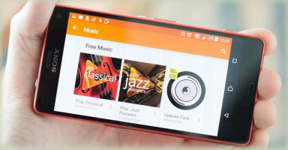
Interactive System Concepts
Understanding the
design &
development
of interactive systems
to create useful or entertaining applications.

Slide 5
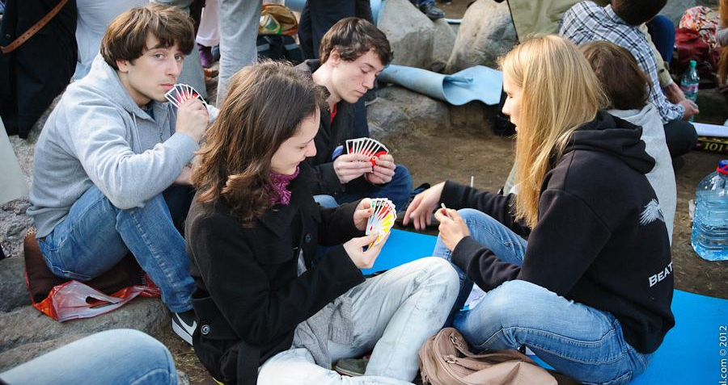
Interactions
Image by Evgeny Isaev, on Flickr https://www.flickr.com/photos/43257267@N08/7174600890 licence CC:BY

Slide 6
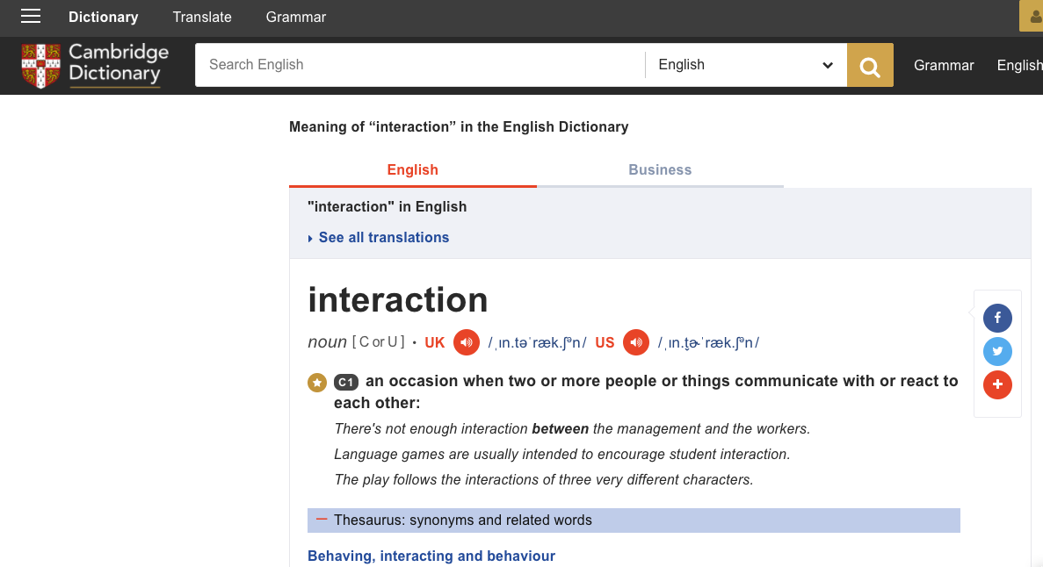
An interaction is… ?

Slide 7
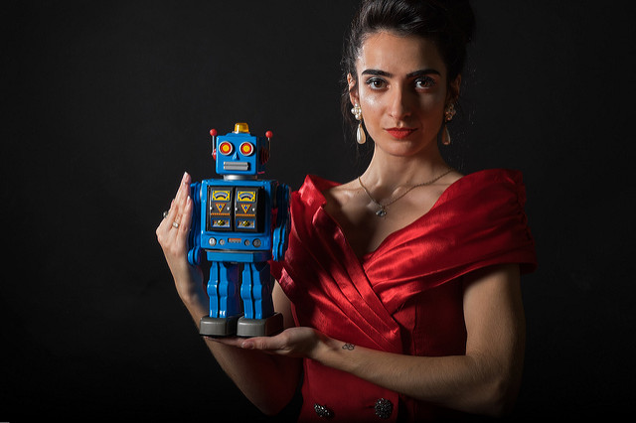
An agent is...
a person, robot or software program
https://www.flickr.com/photos/neesam/

Slide 8
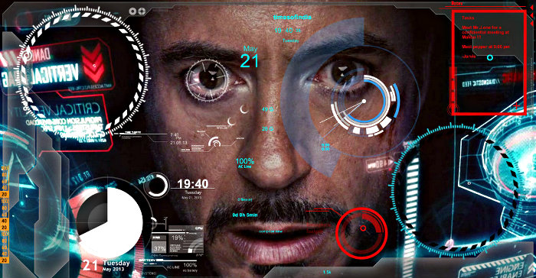
Interactions
Image from http://www.thegeekocracy.com/cool-iphone-interface-marvels-iron-man-3-jarvis-ios-app/

Slide 9
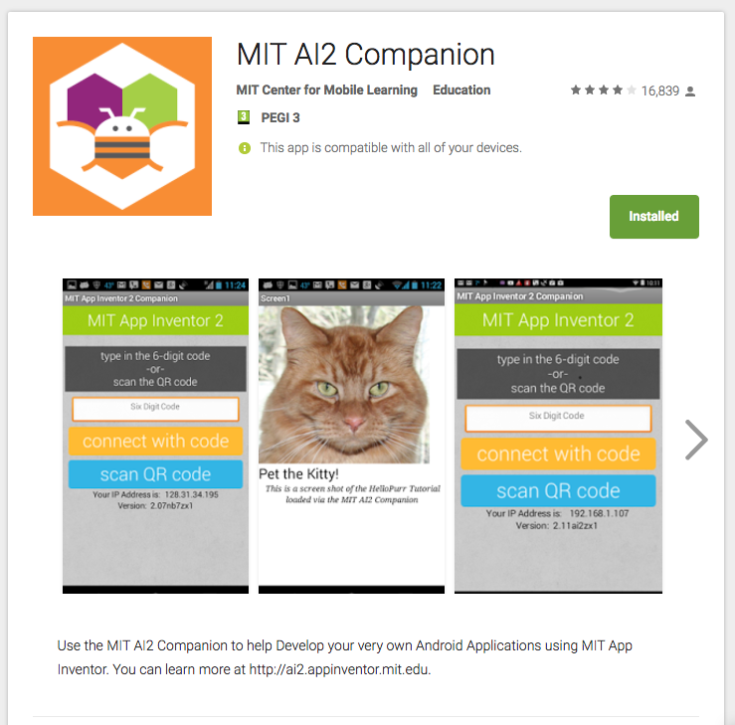
Your labs & coursework...
http://appinventor.mit.edu/explore/get-started.html

Slide 10
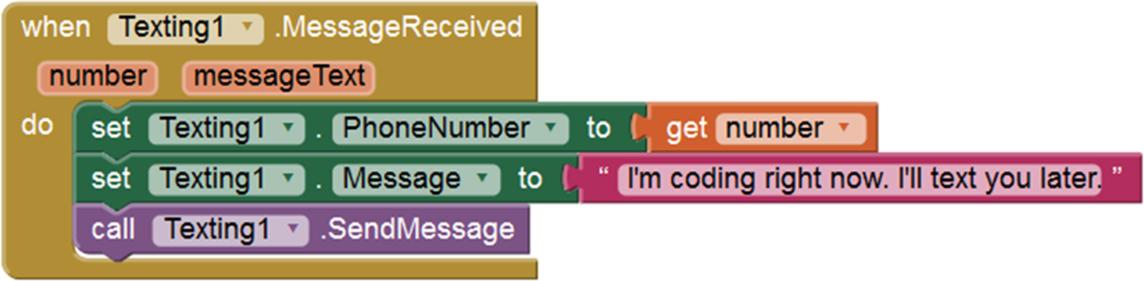
Interactions
Not coding
This is about what to code, not how to code.

Slide 11

… is for you to about what makes a good app for the user
https://www.flickr.com/photos/centermez/
Notes:
In this course you will develop a basic android app, BUT the goal is for you to start thinking about WHAT makes a good app. Focusing on the user centric aspects!

Slide 12
What is this course about?
Interactive system (IS) concepts
Reflective learning

Slide 13

Learning
Image by Phil Barker, on Flickr https://www.flickr.com/photos/philbarker/4663480615/ licence CC:BY

Slide 14
Learning
Image by Phil Barker, on Flickr https://www.flickr.com/photos/philbarker/4663480615/ licence CC:BY

Slide 15
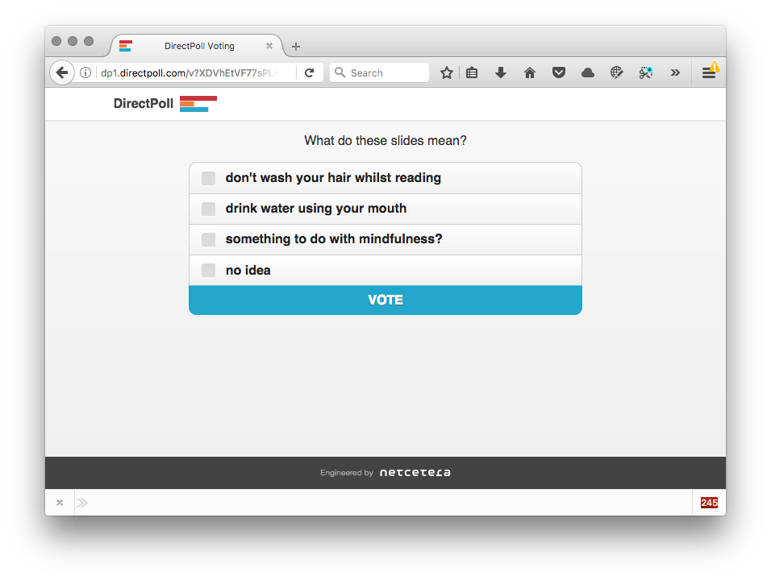
What do these slides mean?

Slide 16
Reflective learning
Experience
To learn you must
consciously think
and analyse what you do or have done
A structured approach helps you reflect on your own learning and understand your own learning processes.
Experiment
Reflect
Conceptualize

Slide 17
How can reflection guide design?
Reflect
What did I learn
What worked well
What didn’t work well
My questions
My observations
Key/new concepts learnt
...
Plan
What do I want to do
What should continue
How to put this learning into practice
What would I do differently
What to do if something is unclear
...

Slide 18
Reflecting on Your Progress
As you work on your project, you make want to make notes on your progress
This will help you to plan and execute your design
This is for yourself, not marked
But it will help you to write about your design process for your final report

Slide 19




You can get creative...
http://langwitches.org/blog/2014/11/23/blogging-for-learning-mulling-it-over/
https://www.flickr.com/photos/128629824@N06/

Slide 20
Peer Feedback
You’ll be asked to give each other feedback on your projects
This is assessed
  Peer feedback makes up part of your mark
  The quality of your feedback is marked
We’ll talk more about how to give feedback in the coming weeks
You’ll be expected to take feedback into account when you revise your design

Slide 21
Giving Peer Feedback
Be respectful and helpful
Give praise and support as well as criticism whenever appropriate
Ask questions!
How might they do better?
What can you learn from them?

Slide 22

Time Expectations
Full time students:
work 35 hours per week
~8 hours per course,
per week
For this course:
you have 3 hours timetabled…
what about the other 5?
https://www.flickr.com/photos/aircraftsincruise/

Slide 23
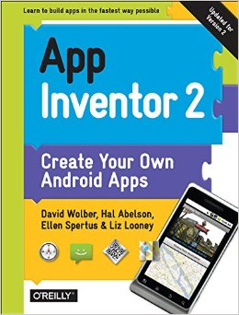

Books and websites
http://www.appinventor.org/book2
http://appinventor.mit.edu/explore/get-started.html
http://www.appinventor.org/course-in-a-box2

Slide 24
Books and websites
Beware of differences between the original App Inventor and App Inventor 2
http://www.appinventor.org/book2
http://appinventor.mit.edu/explore/get-started.html
http://www.appinventor.org/course-in-a-box2

Slide 25
App Inventor discussion
Hal Abelson says that an experiment like App Inventor could only be done with Android, because it’s so "open". Does he mean "open source?" What does he mean?

Slide 26
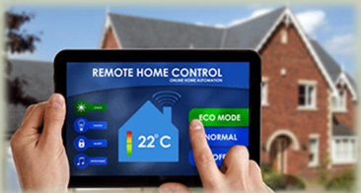
Apps discussion
What issues should be considered when creating app to control a smart home?

Slide 27
Apps discussion
Security
Standards
Usability
Finding apps

Slide 28
Lab 1
You will be creating an Android App
If you have your own Android device, bring it!
If you do not have an Android device:
  Let me know

Slide 29
Setting Up App Inventor
http://appinventor.mit.edu/explore/ai2/setup.html
http://appinventor.mit.edu/explore/ai2/setup-device-wifi.html
http://appinventor.mit.edu/explore/ai2/setup-emulator.html
http://appinventor.mit.edu/explore/ai2/setup-device-usb.html
http://appinventor.mit.edu/explore/content/windows-drivers.html
https://developer.android.com/studio/run/oem-usb#Drivers
Notes:
If you're developing on Mac OS X or Linux, then you shouldn't need a USB driver. Instead read Using Hardware Devices.

Slide 30
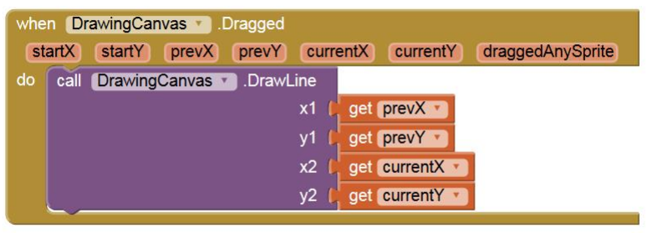
App Inventor question
The Canvas.Dragged event has event parameters. For the Dragged event, what to startX and startY represent?
Notes:
On all calls, the starting coordinates are where the screen was first touched, and the "current" coordinates describe the endpoint of the current line segment. On the first call within a given drag, the "previous" coordinates are the same as the starting coordinates; subsequently, they are the "current" coordinates from the prior call. Note that the Sprite won't actually move anywhere in response to the Dragged event unless MoveTo is specifically called.

Slide 31
Tutorial 1
http://appinventor.mit.edu/explore/ai2/hellopurr.html

